Slide 1
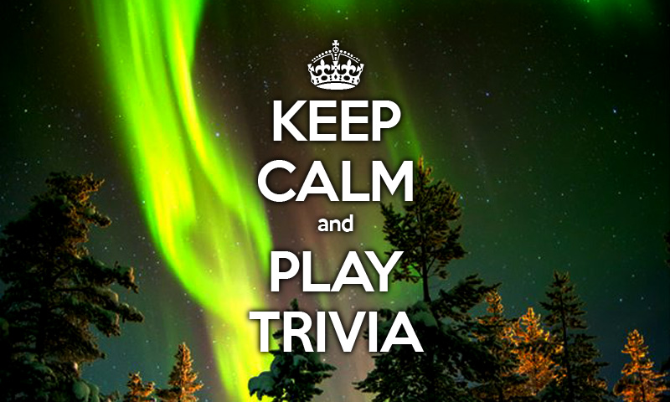

Slide 2
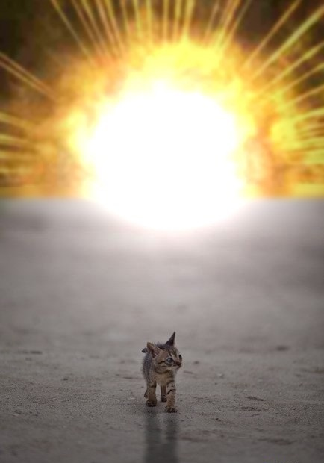
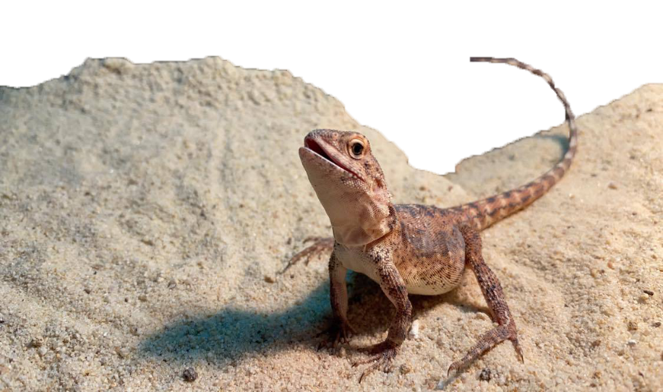
ATOMIC
KITTEN!
GROOT

Slide 3
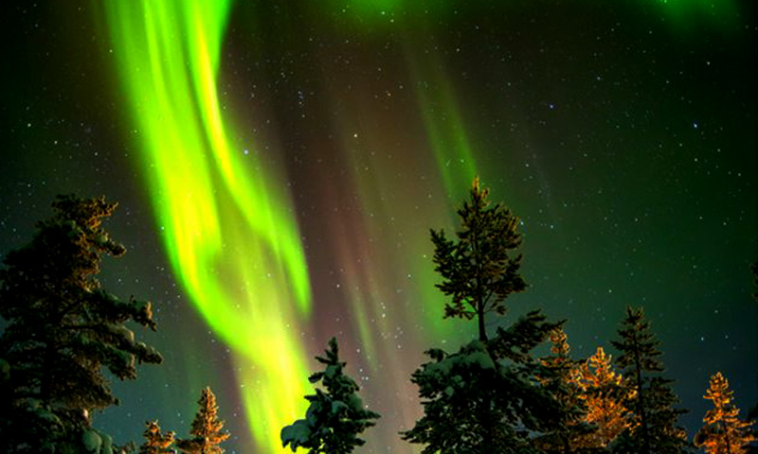
ROUND ONE

Slide 4
QUESTION 1
Mythology
What is the name of the Mayan Rain God

Slide 5
QUESTION 2
What is the name of the toxic poison found in Potatoes? (Also found in Tomatoes, Chilies &Eggplant)

Slide 6
QUESTION 3
What is the meaning of Life, the Universe, and Everything?

Slide 7
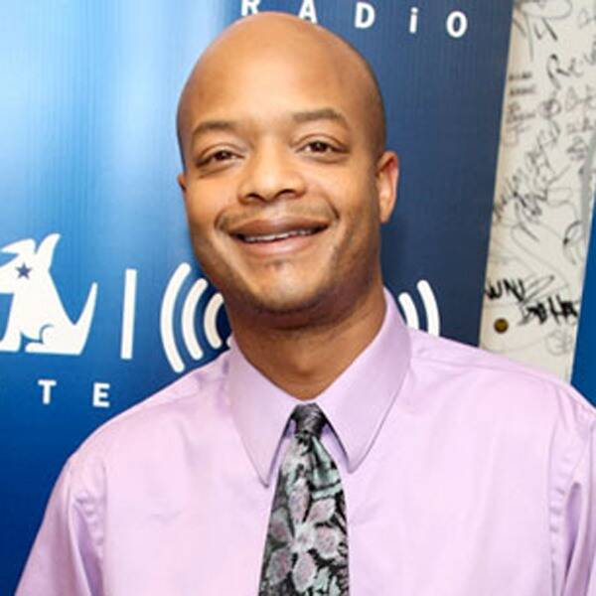
QUESTION 4

Slide 8
QUESTION 5
There are 10 cities in the ancient great Roman Decapolis, most of which are now inside modern Jordan. Which of these cities is known in Arabic as Tabaqat Fahil.

Slide 9
QUESTION 6
Which nursery rhyme, originating in Ireland, involves educating children in counting, by holding up both your fists and counting them while singing…?

Slide 10
QUESTION 7
Which Author wrote the books known as The Faraway Series

Slide 11
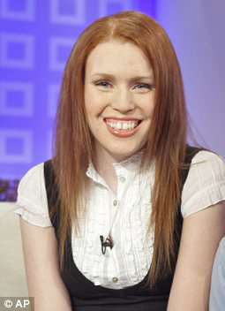
QUESTION 8

Slide 12
QUESTION 9
In what country would you find the currency which abbreviates to ISK?

Slide 13
QUESTION 10
What is the name of the element also commonly known as Wolfram?

Slide 14
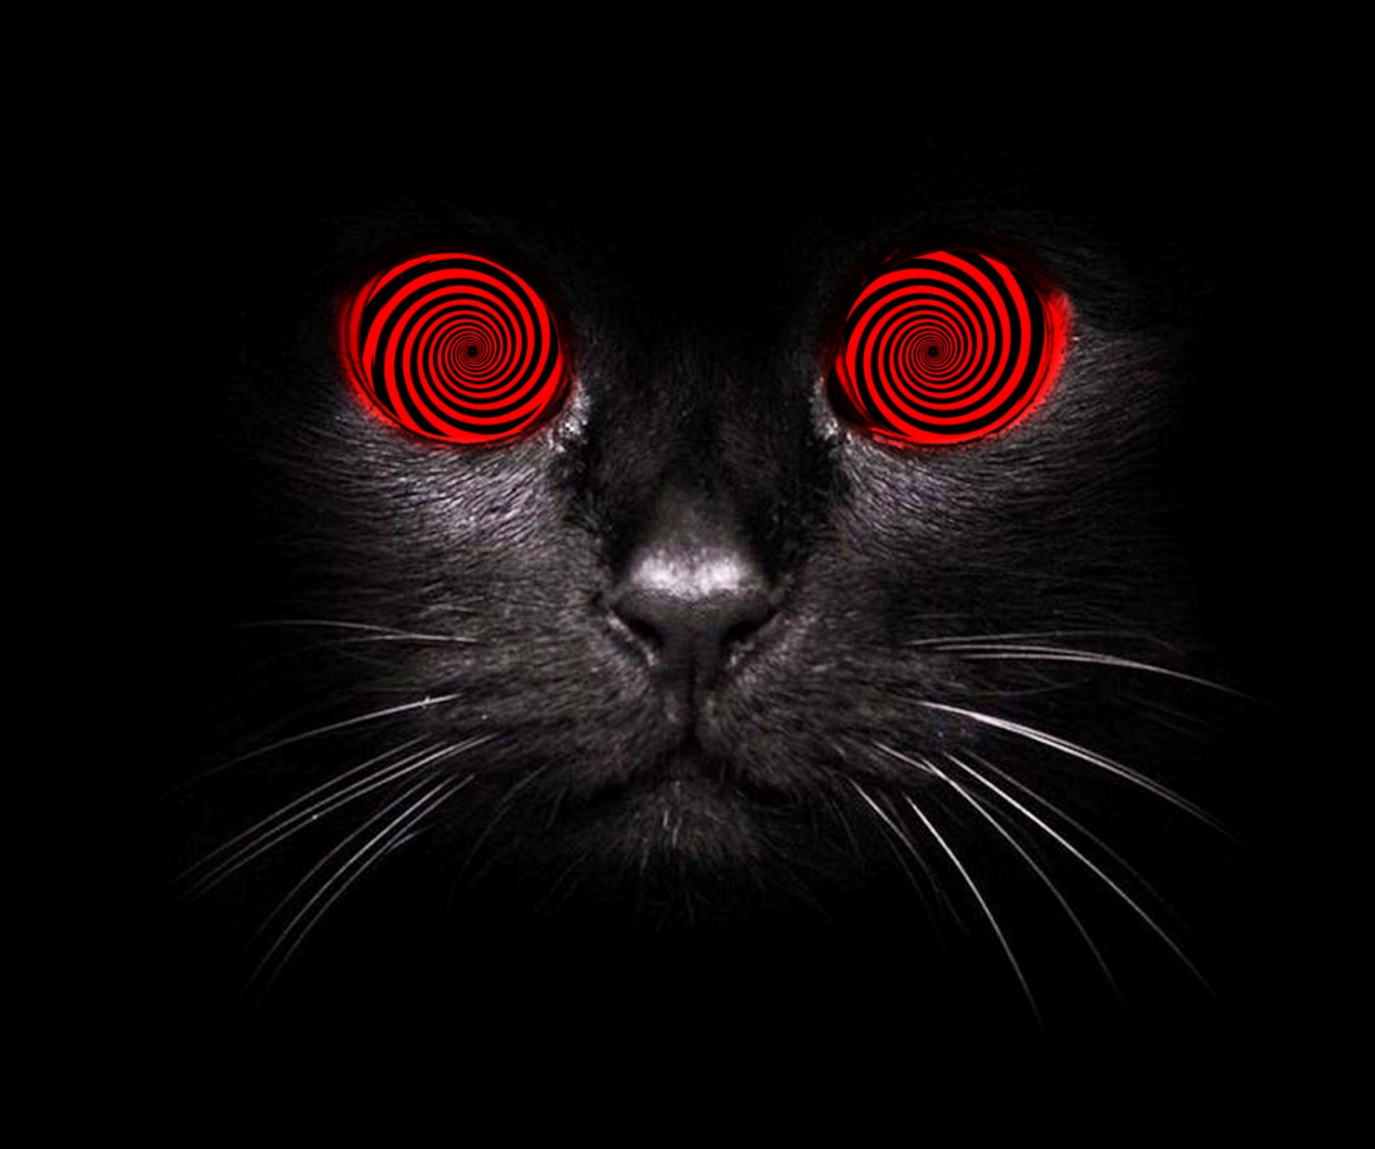
BEER ONE

Slide 15
QUESTION 11
There are over 4000 native, and common varieties of Potatoes in the world. Which variety of common potato does McDonalds prefer to use to make its famous French Fries?

Slide 16
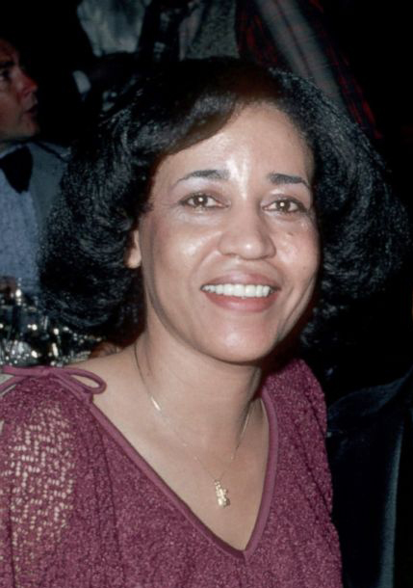
QUESTION 12

Slide 17
QUESTION 13
Who was the longest serving
Soviet Leader?

Slide 18
QUESTION 14
On what Australian beach was the first Surf Life Saving Club founded in 1906?

Slide 19
QUESTION 15
Does an Atomic Bomb rely upon Nuclear Fission or Nuclear Fusion?

Slide 20
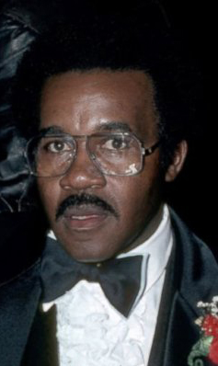
QUESTION 16

Slide 21
QUESTION 17
What do all the pictures in round one have in common?

Slide 22
QUESTION 18
Which actor died while filming ‘The Crow’?

Slide 23
QUESTION 19
True or False
M&Ms stands for, ‘Mars and Moordale’?

Slide 24
QUESTION 20
Numbers Game
Lafayette Ronald Hubbard, Author and founder of the Church of Scientology was also an author who holds the Guinness Book of Records for ‘most novels written by a single person’. How many novels did he write?

Slide 25
HUNTER
WILDLIFE
RESCUE
MID GAME MINI-TRIV!

Slide 26
ROUND TWO

Slide 27
QUESTION 1
Name the river that runs through Tamworth

Slide 28
QUESTION 2
Yorick’s skull appears in which of Shakespeare’s tragedies?

Slide 29
QUESTION 3
Which City was it said that the mythological twins Romulus and Remus founded?

Slide 30
QUESTION 4

Slide 31
QUESTION 5
Octopus, Squid and Inkfish are from what family of sea creatures?

Slide 32
QUESTION 6
Riddle me this!
What runs around the
whole yard without moving?

Slide 33
QUESTION 7
The Pulitzer Prize-winning novel To Kill a Mockingbird, first published in 1960, was penned by whom?

Slide 34
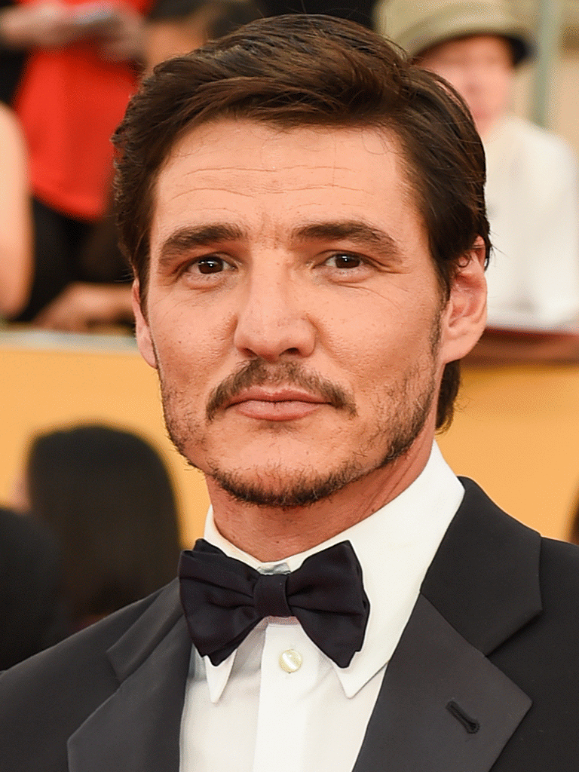
QUESTION 8

Slide 35
QUESTION 9
9 - Mountaineer Sir Edmund Hillary was from which commonwealth country?
Mountaineer Sir Edmund Hillary was from which Commonwealth country?

Slide 36
QUESTION 10
Small trace impurities affect the colour of diamonds. The most common impurity present is Nitrogen; what colour does this turn a diamond?

Slide 37
BEER TWO

Slide 38
QUESTION 11
Name the Australian Aerobatic Pilot and Novocastrian, who finished 3rd in the 2009 Red Bull Air Race series?

Slide 39
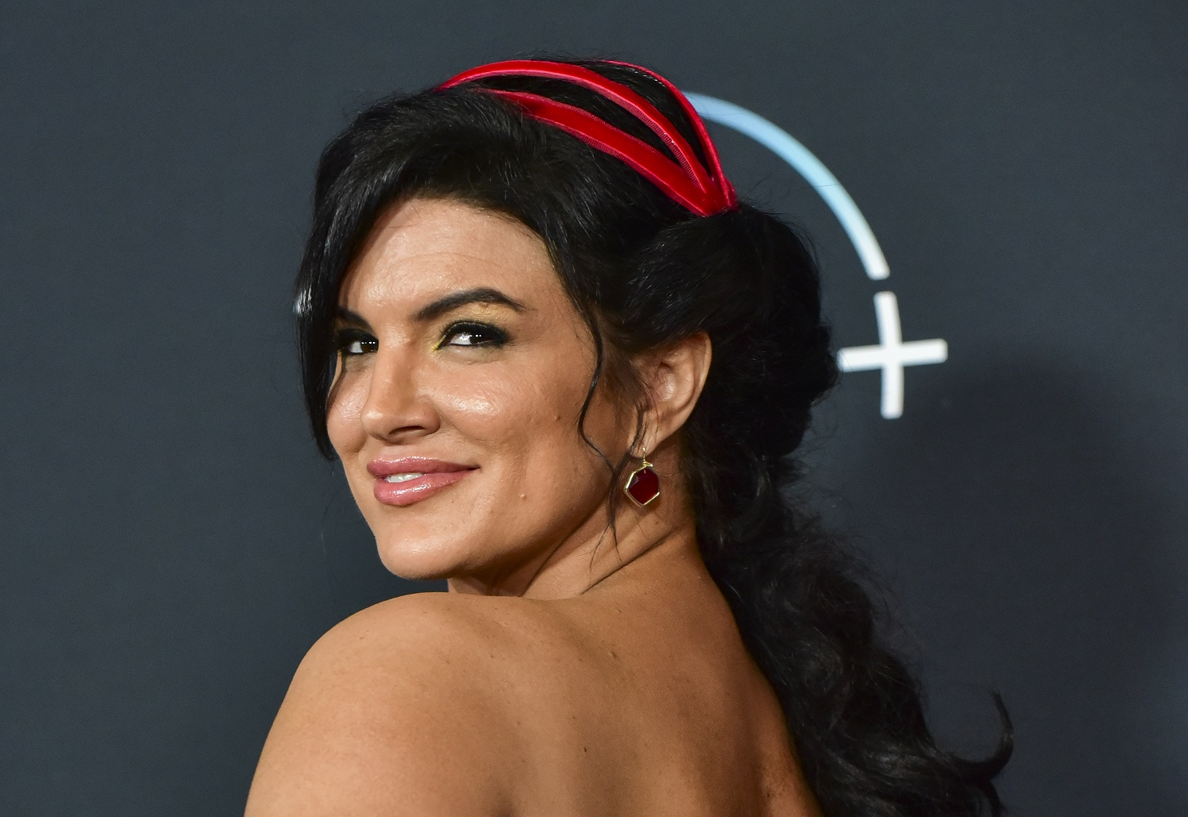
QUESTION 12

Slide 40
QUESTION 13
Phobia!
Triskaidekaphobia describes a fear of... what?

Slide 41
QUESTION 14
Wish respect to the Soviet Union, what does USSR stand for?

Slide 42
QUESTION 15
Collective Nouns
What is the collective noun for a group of Oysters?

Slide 43
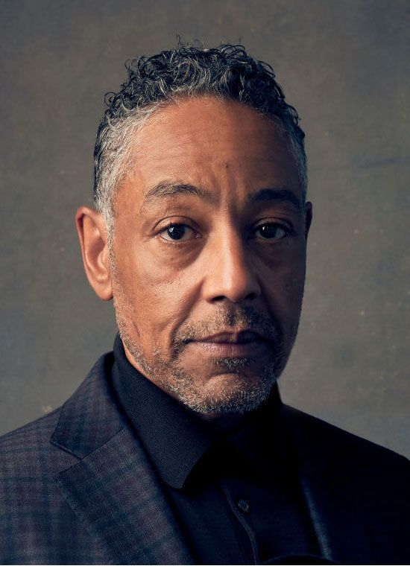
QUESTION 16

Slide 44
QUESTION 17
What does everyone in the round two pictures have in common?

Slide 45
QUESTION 18
Prior to re-unification, that was the capital city of West Germany?

Slide 46
QUESTION 19
What is the name of the dot that is part of the lower case i and j letters?

Slide 47
QUESTION 20
Released in 2013 by a New Zealand singer, name the Artist and the Song which begins with the Lyrics:
“I’ve never seen a diamond in the flesh. I cut my teeth on wedding rings in the movies. And I’m not proud of my address in a torn up town, no postcode envy”

Slide 48
JACKPOT

